Slide 1
TCS
Team Collaboration System for Mobility Water Monitoring

Slide 2
Water Monitoring Process

Slide 3
Problem
Water Monitoring Process

Slide 4
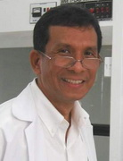
  The research center of the faculty of science (Chiang Mai university)
I-ANALY-S-T
  >>>The research center of the faculty of science
  (Chiang Mai university)
  >>>Developed a mobile application for chemical analysis regarding to water quality with the test kit
  - Record the test result instantly without taking to the lab
  - Quickly measure the water sampling
  - Prevent the changing of the water’s element
  But >>>>

Slide 5
Standalone application
The Problem occurred
I-ANALY-S-T
  Do not provide a traceability
  Cannot share the data instantly
BUT!!!!!
  Difficult to retest
  Cannot identify the collector

Slide 6
How to solve the problem?
Create central system
Controls by the team leader
Identify the responsibility each of collectors
Share information instantly
Calculate the water parameter and share the result instantly
Trace back of water test evidence

Slide 7
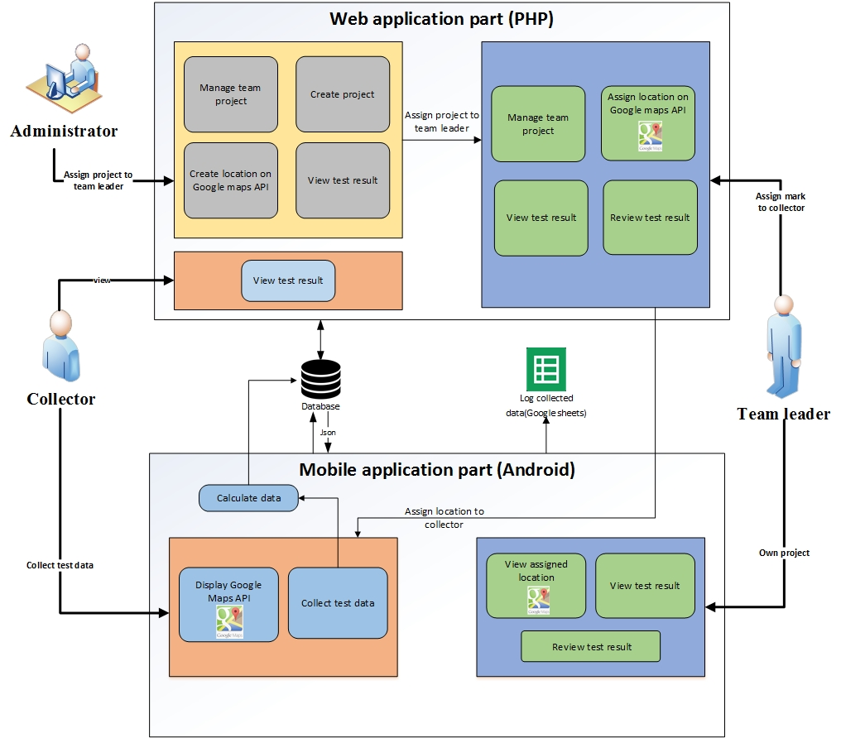
System Architecture

Slide 8
Technology Review

Slide 9

php
Technology Review
Open Source
Supported every operating system(Windows, Linux, ….)
Supported every browser (IE, Firefox, …)
Script language is easy to understand

Slide 10

Android
Technology Review
Free open source
An open source development platform for creating applications.
of tutorials and the Android plugin for Eclipse

Slide 11

Google Maps
Technology Review
Supports calculating distance between locations
Working with Android SDK
Providing longitude and latitude

Slide 12

Google Spreadsheet
Technology Review
Easy to use likes MS Excel.
Can use the data to verify the history
by doing the traceability record

Slide 13
Development Tools Review

Slide 14

Eclipse with ADT
Development Tools Review
Open Source
Supported Android Development Tools

Slide 15
Development Tools Review
ADT Plug-in for Eclipse

Slide 16
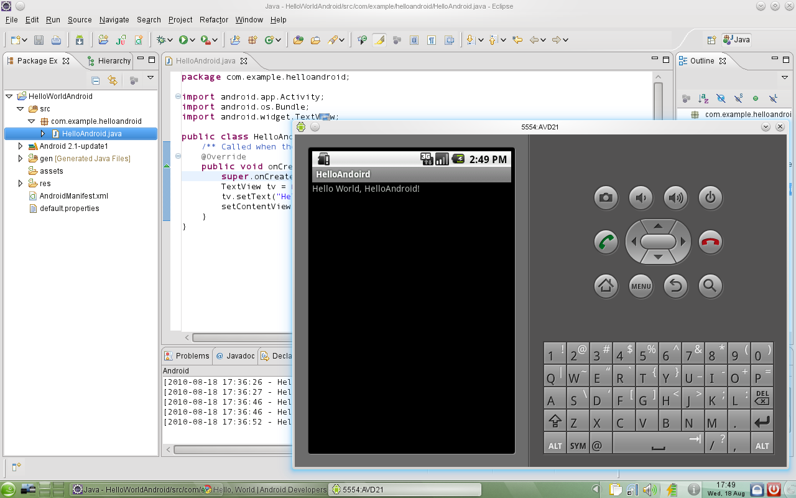
Android SDK
Development Tools Review
The programmer can use Android SDK to develop application and test it on the emulator which similar to the real Android phone

Slide 17

Development Tools Review
JetBrains PhpStorm 7.1.31
PhpStorm’s smart code editor provides excellent support for PHP

Slide 18

XAMPP
Development Tools Review
Free and easy to install, and no configuration is needed to make APACHE, PHP & MYSQL compatible with each other.

Slide 19
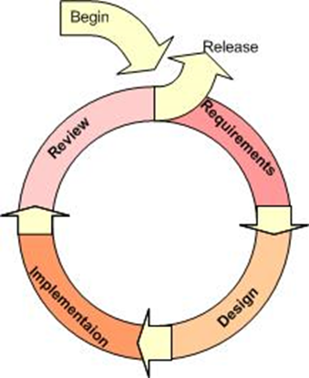
Iterative Model
Supports changing requirement
Can get the reliable user feed back
Can track the defects at early stages

Slide 20
Quality Standard
ISO29110 for Very Small Entity (VSE)
Very Small Entity (VSE) is defined as an entity (enterprise, organization, department or project) having up to 25 people. VSEs also develop and/or maintain software that is used in larger systems, therefore, recognition of VSEs as suppliers of high quality software is often required.

Slide 21
Project Plan

Slide 22
Aims and Objectives
The aims of this project is to develop the mobility water monitoring system in order to manage the team project and share test information to the working team.

Slide 23
Aims and Objectives
1.
jy
To create the central system support team collaboration
2.
To help managing project teams
3.
To help identifying the collectors responsibility

Slide 24
Aims and Objectives
4.
To help sharing all test results aggregated to the evaluation
5.
To be able to trace back the test result from the research center
6.
To reduce the time of working as a team

Slide 25
Feature
Deliverables
1
2
3
Authentication and member management system
Map location
management
Project management

Slide 26
Feature
Deliverables
4
5
6
Water parameter
calculation
Parameter result
tracing
Messaging system

Slide 27
Limits
The internet connection is required for using this system and application.
Smart device, which are using Android OS.
กล้องงงงงงงงงงงงงงงงงงงงงงงงง
Website support only English language

Slide 28
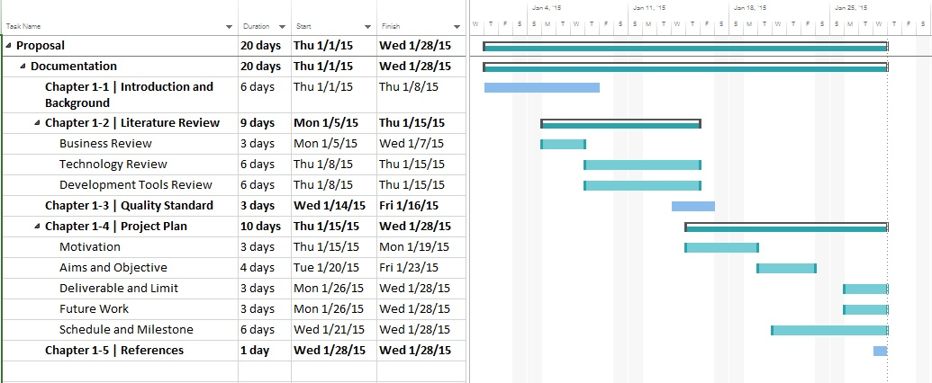
Schedule & Milestone

Slide 29
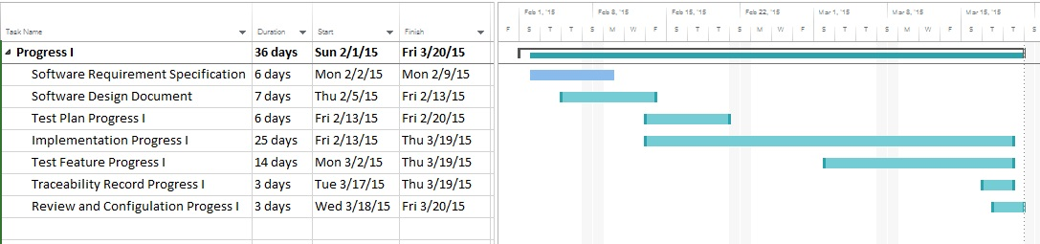
Schedule & Milestone
Progress Report 1
Feature 1: Authentication and member management system
Feature 2: Project management

Slide 30
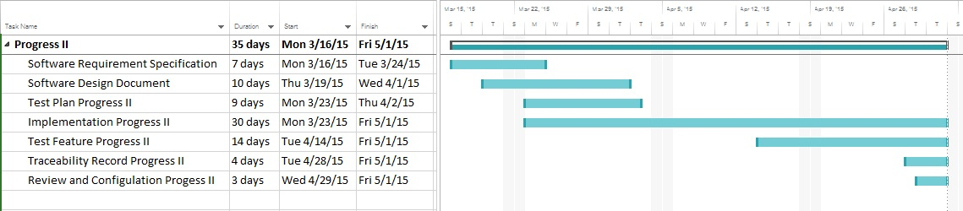
Schedule & Milestone
Progress Report 2
Feature 3: Project browsing
Feature 4: Map location management
Feature 5: Result presentation

Slide 31
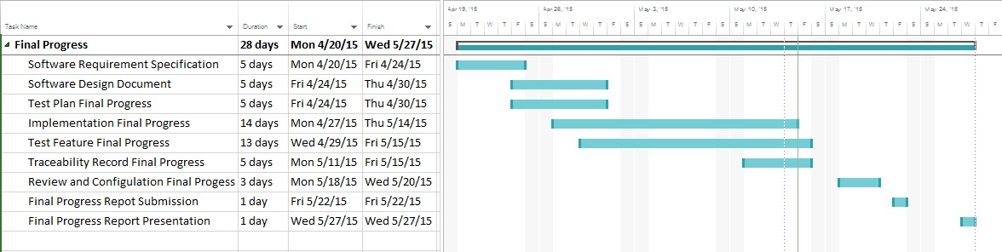
Schedule & Milestone
Progress Report 3
Feature 6: Messaging System
Feature 7: Extension of existing application

Slide 32

Future work
iOS

Slide 33
Q&A
THANK YOU

